Slide 1
Welcome to the IHA Administrative Professionals Conference!
July 29, 2022

Slide 2
Administrative Professionals Conference July 29, 2022 Laurie Gerdt, LMHC Quality and Patient Safety Advisor Indiana Hospital Association
Notes:
Good Morning and thank you so much for having me. My name is Laurie Gerdt and I am one of the Quality and Patient Safety Advisors with the Indiana Hospital Association.

Slide 3
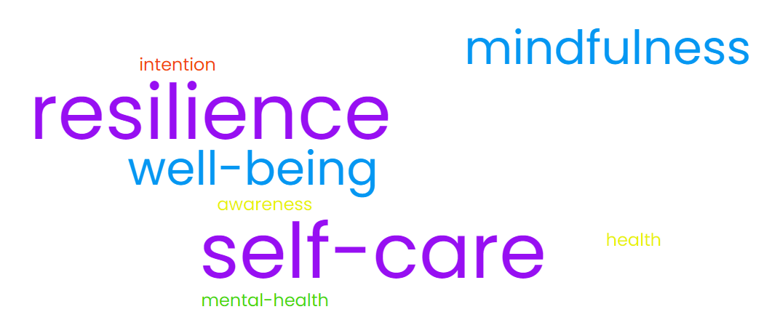
Buzz Words
Notes:
I am fully aware of the potential eye rolls and sighs that may come along with my presentation. Presenting on topics that use buzz words like self-care, resilience, mental health, mindfulness, etc……however, overuse of the buzz words does not negate the fact that some of these techniques are scientifically proven to be effective via neuroscience and research.

Slide 4
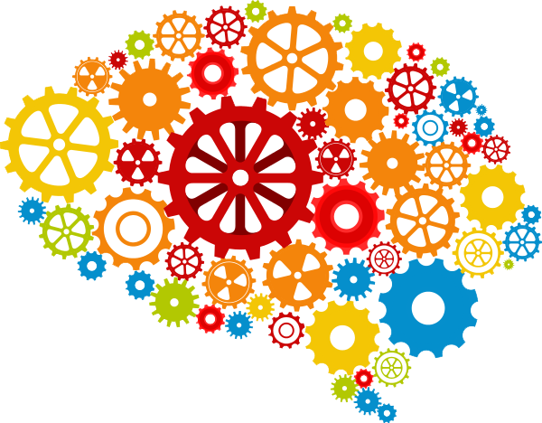
Burnout and Resilience
Notes:
So my hope is that by the end of my presentation each one of us feel like our minds are more like the image on the right, well-organized, high functioning, bright and energetic. To get there, we need to be honest with ourselves about our current state. So let’s spend just a few minutes defining burnout.

Slide 5
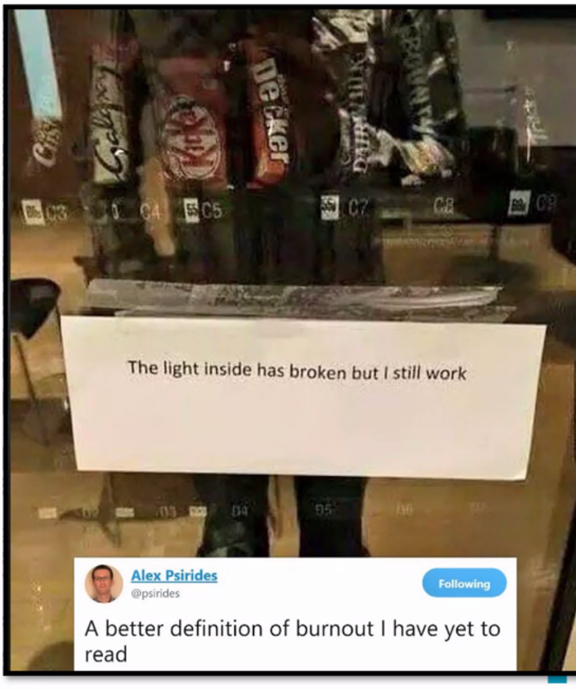
What is Burnout?
Frustration
Emotional exhaustion
Cynicism
Inefficacy
Depersonalization
Notes:
According to an October 20, 2020 American Hospital Association article, “In 2019, “burnout” was added to the International classification of diseases.
Christina Maslach, PhD Professor Emeritus, Berkeley has a definition that is used widely and captures what the term burnout is trying to describe. She cites the symptoms of burnout as frustration, emotional exhaustion, cynicism, inefficacy, and depersonalizing. Or as this image of a vending machine with its’ light broken illustrates “the light inside has broken but we still work”. Presenteeism vs absenteeism

Slide 6
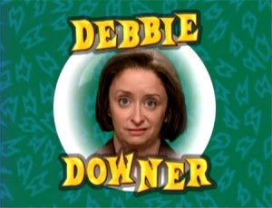
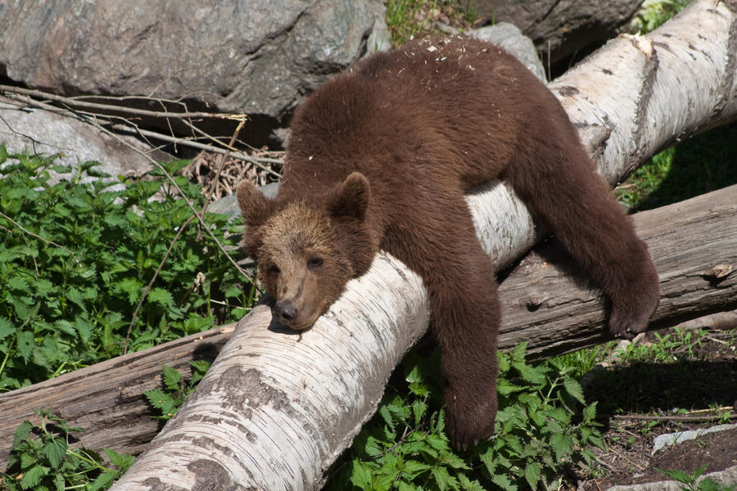
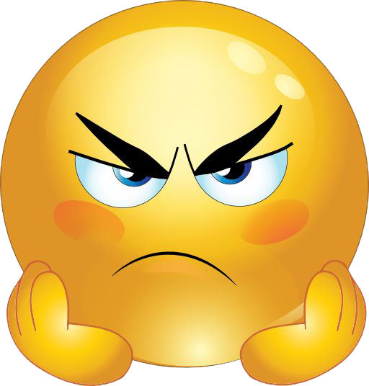
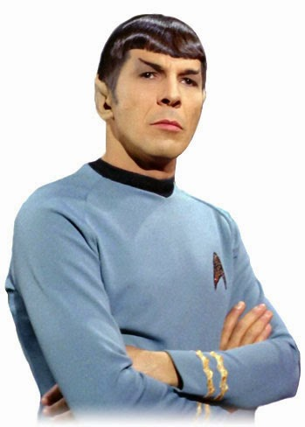
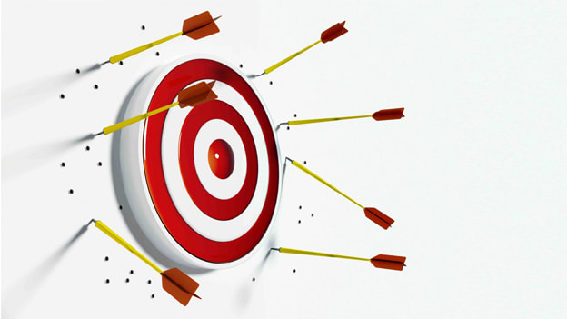
Mindfulness Activity: Name It to Tame It
Notes:
Let’s take a minute to reflect on which of those burnout symptoms rises to the top for us? Why this identification is important is because choosing words to describe subtle emotions jump-starts your executive brain and calms down your emotional limbic brain. Or we can just call this Name It To Tame It – This phrase was coined by author and psychiatrist Dr. Daniel Siegel. Once you notice you are having an emotional reaction or lack thereof, the next step is to name it – whether to yourself or out loud.
So which of these symptoms did you carry in with you today? Or when you go into a meeting? Are you the human version of the Frustration Emoji? Are you the Debbie-Downer Cynic? Are you missing the mark, a lot? Inefficacy? Have you gotten to Spock levels of Depersonalization? Are you just plain emotionally exhausted?
Pick the associated image from the center of the table or if you are participating virtually, write down which symptom of burnout you identify with the most on piece of paper.
Now, Which emotions go along with these symptoms of burnout? Ambivalence or having mixed emotions? Apathetic or just not caring anymore, almost numb? Helpless, or even feeling incapacitated or incompetent, like you can’t get anything done? Or are you feeling hopeless, not being able to see any light at the end of the tunnel, so why bother? What about anxious, that extreme uneasiness of the mind or even a brooding fear? Notice I did not use the common more simplistic emotion words of sad, mad, and scared. That is because we really need to identify those subtle, complex, and POWERFUL emotions that drive our behaviors. That is what engages our executive brain to calm down that emotional limbic part of our brains……neuroscience, not making this up!
Now take that piece of paper with the image of your associated burnout symptom, flip it over and write which emotion, any of the ones I said or any other complex emotion you experience when feeling burned out, on the back of that piece of paper. For those in the virtual space, simply write down the emotion next to the symptom of burnout you already wrote down. You all just Named it to Tame it. Keep these on hand, I am going to reference back to them here in a little bit.

Slide 7
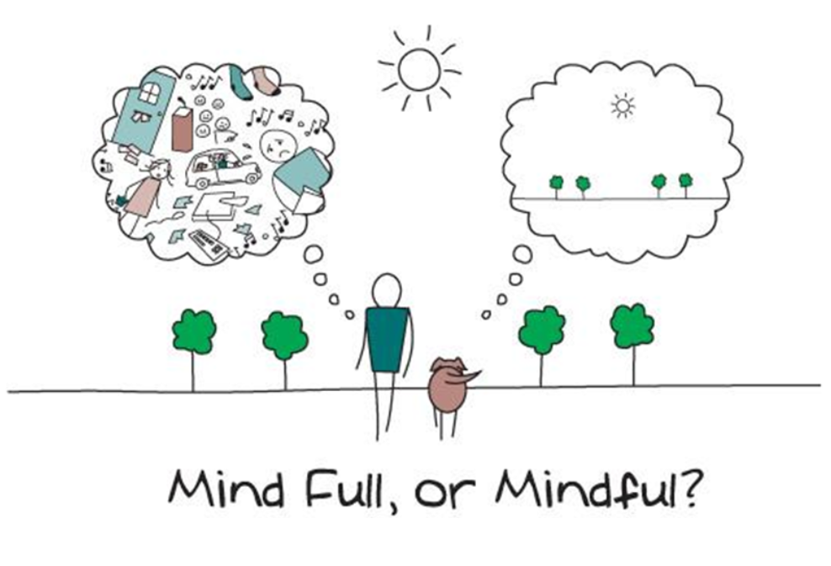
Power Tool: Mind FULL vs. Mindful (coachcampus.com)
Notes:
Okay, now that we have talked about the buzz word of burnout. Let’s talk about another buzz word…..mindfulness. I would like to take a minute to move us from the identification stage to the learning phase by focusing on what we can control and what we cannot control. Are we Mind Full or Mindful…….Mind FULL is messy, sad, overwhelming, unproductive, not good. Mindful on the other hand is calm, productive, and nice – like eating a warm chocolate chip cookie.
Mind FULL is future focused whereas being mindful is ‘now’ focused. Mind FULL adds two items to your to-do list for each one you check off. Mindfulness lets you enjoy one moment, task or event at a time.
You may be asking yourself, “Why is a full mind bad?” Generally someone with a lot on their plate is praised for having it ‘all together.’ The always on-the-go busybody is seen as a person of talent, a dynamo, or a high achiever but is that the truth? If we could hover quietly over the busybody for a day what would we see? True accomplishment, or empty tasks? If the latter, discontentment stirs inside causing the busybody to want to fill himself with more to do or think about, causing more chaos in his mind.
If this is an unhealthy practice then why do we continue on this path?
1. Fear: FOMO or wanting to have our fingers in every pie so to speak.
2. Unawareness: For those unfamiliar with self-awareness, mindfulness is a foreign concept. Those unaware to mindfulness might say, “Is that some sort of buddha thing?” or “I’m not good at meditating.” They have not a clue because it’s just not part of their programming. Those in this category can have the greatest awakening when they realize this state of being is available at any moment.
3. Doubt: The third category of full minded folks knows mindfulness is out there, but they believe they can’t have it. It’s for someone else who isn’t as busy as they are.
I tried to relax before and it didn’t work
I can’t stop and enjoy this, I’m too busy
So-n-so is doing more than I am so I have to catch up
I’ll sleep when I’m dead
I feel anxious when I’m not busy
People will think I’m lazy

Slide 8
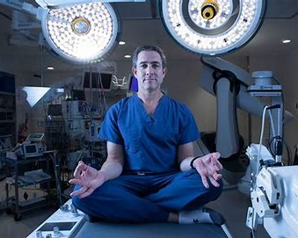
Gritflowness: Using Grit, Flow and Mindfulness to Reduce Stress | AANS Neurosurgeon
Notes:
And if you don’t take it from me, then let me introduce you to Dr. John Boockvar, a neurosurgeon at Lenox Hill in New York who practices this type of mindfulness before every surgery although he calls it Gritflowness………Grit is the tenacity and passion that one brings in the pursuit of long-term goals. Research has consistently demonstrated that grit is a strong independent predictor of sustained career satisfaction and achievement. FLOW = complete concentration, during which the highly challenging task at hand feels effortlessly completed. Flow states may be found in the operating room or classroom and any activity, such as playing sports. This requires being able to assume a focused mental state in which one is unaware of the distractions. Setting aside the chaos is important in all aspects of life in order to continue achieving challenging goals. Mindfulness maintains one’s alertness and attention, filtering the constant stream of potential distractions. Not only does mindfulness have psychological benefits, but neuroimaging studies have also shown that mindfulness can engage mechanisms of neural plasticity. In one study, MRI images of participants who practiced mindfulness for eight weeks showed an increase in gray matter density in brain regions implicated in learning, memory and emotion.3 Another study showed that those who practiced mindfulness had decreased amygdala activation in response to emotional stimuli….remember the Name it to Tame it? Neuroscience back at it again! , which suggests that people who meditate can have more regulated reactions to fear and stress.

Slide 9
Mindfulness Activity
Notes:
So let’s practice…..
Grab whatever drink you have or imagine your favorite drink if you do not currently have something to sip: coffee, water, for me it is a McDonald’s diet coke
Next, Think of that complex emotion we identified earlier. Think of a situation that evokes that emotion, maybe something stressful occurred this past week? For me, I am always anxious before presenting in public and I begin to feel like an imposter or not really competent enough to be up here presenting to you all.
Now, I want you to hold your drink in your hands. Is it warm and cozy on your hands? Is it cool and refreshing in your grasp? What does the cup feel like, is it a water bottle that has that nice indentation where it is easy to hold?
Next, does your drink have a scent? Did you add any flavored creamer in your coffee? If it is water, do you notice any other smells around you, maybe you put lotion on your hands or you can smell your aftershave?
Now close your eyes and I want you to take a sip of your drink but do not swallow immediately. Take a minute to savor the flavor and the feel of the liquid in your mouth and on your tongue. I can feel those carbonated bubbles in my mouth or the smoothness of the coffee or the burst of cool from a water. Now you can swallow.
Now how many of you thought about that complex emotion or stressful event that occurred this past week while paying attention to your drink? That is mindfulness and it takes a lot of practice and training our brains but it can be done! It allows ourselves and our brains to slow down for a minute and have some clarity on the present moment which is something we can control. It is a literal rest from stress. Just like a rest in-between sets of exercise..

Slide 10
Virtual Hope Box
Notes:
Chair massage

Slide 11
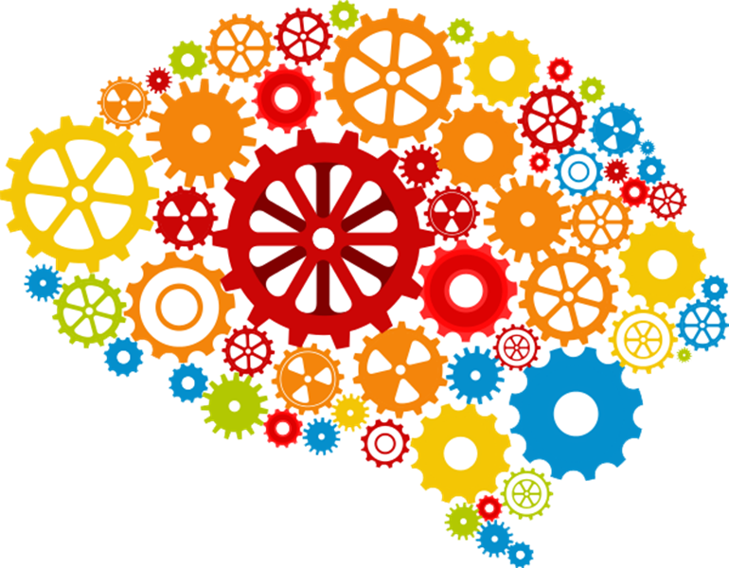
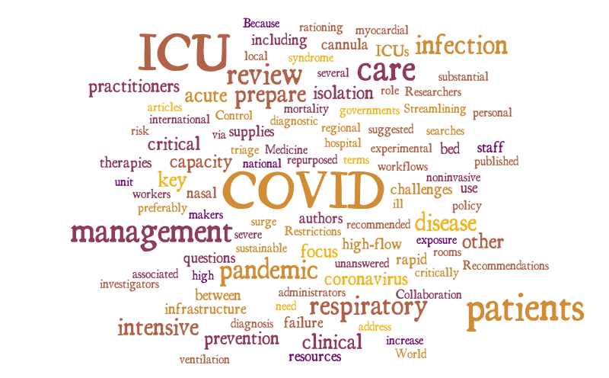
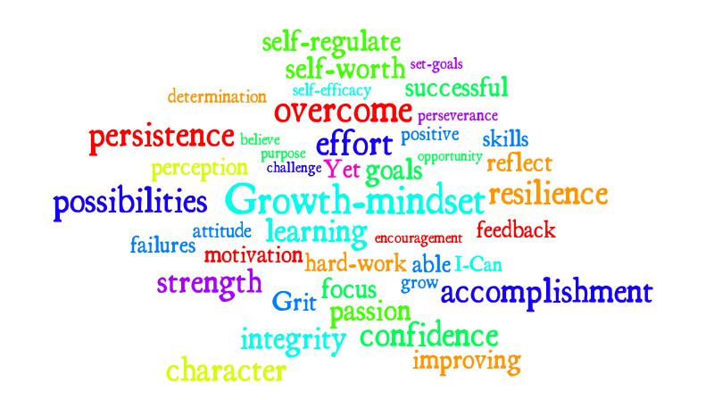
Burnout to Resilience

Slide 12
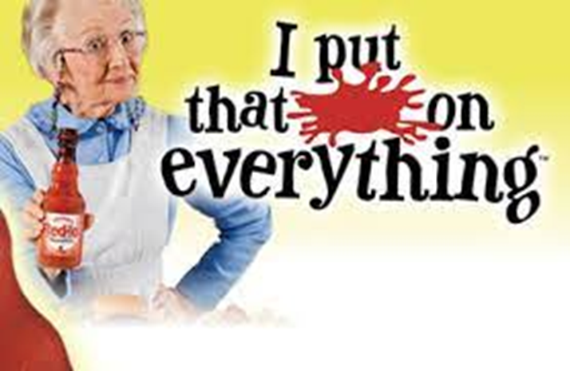
Or…….
Notes:
I’ll practice this stuff everyday!

